Slide 1
BITS Pilani presentation
K. Venkata Ratnam
Mathematics

Slide 2
Course Number : SS ZC416
Course Title: MATHEMATICAL FOUNDATIONS
FOR DATA SCIENCE
Lecture No. :12

Slide 3
Representing relations
Applications of relations
Equivalence relations
Partial order relations
Lattices

Slide 4
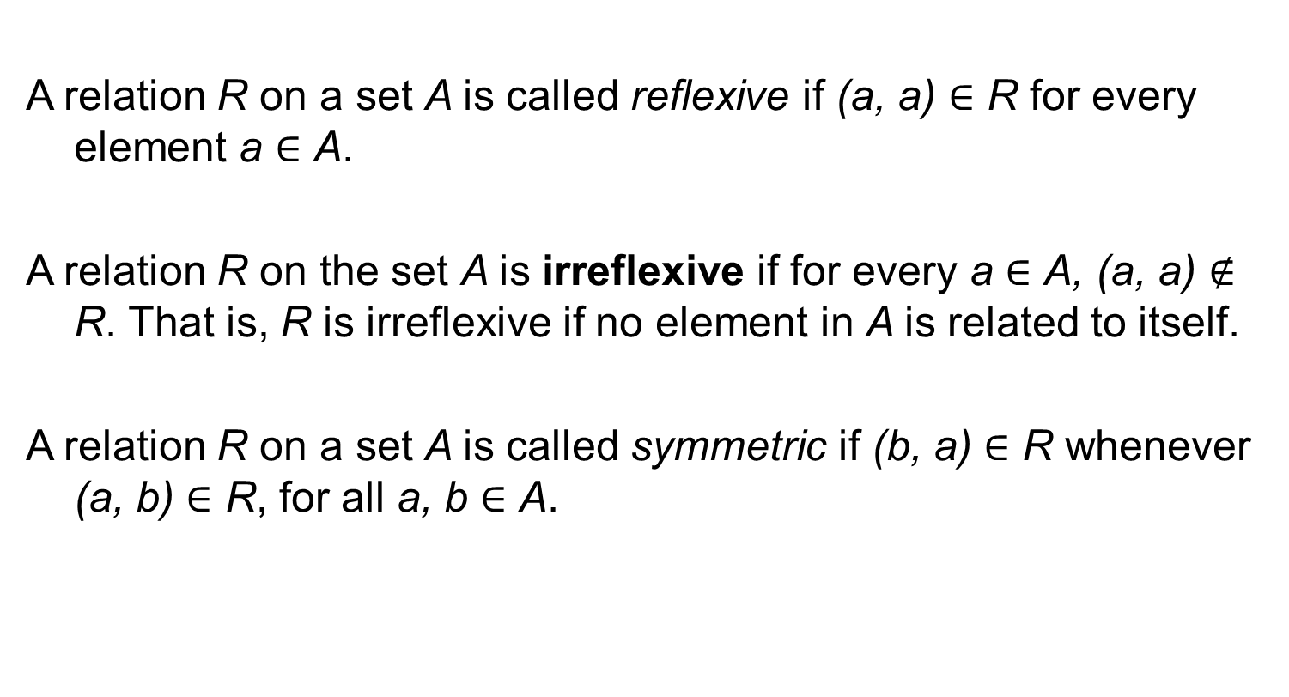
Definitions
A relation R on a set A is called reflexive if (a, a) ∈ R for every element a ∈ A.
A relation R on the set A is irreflexive if for every a ∈ A, (a, a) $∉$ R. That is, R is irreflexive if no element in A is related to itself.
A relation R on a set A is called symmetric if (b, a) ∈ R whenever (a, b) ∈ R, for all a, b ∈ A.

Slide 5
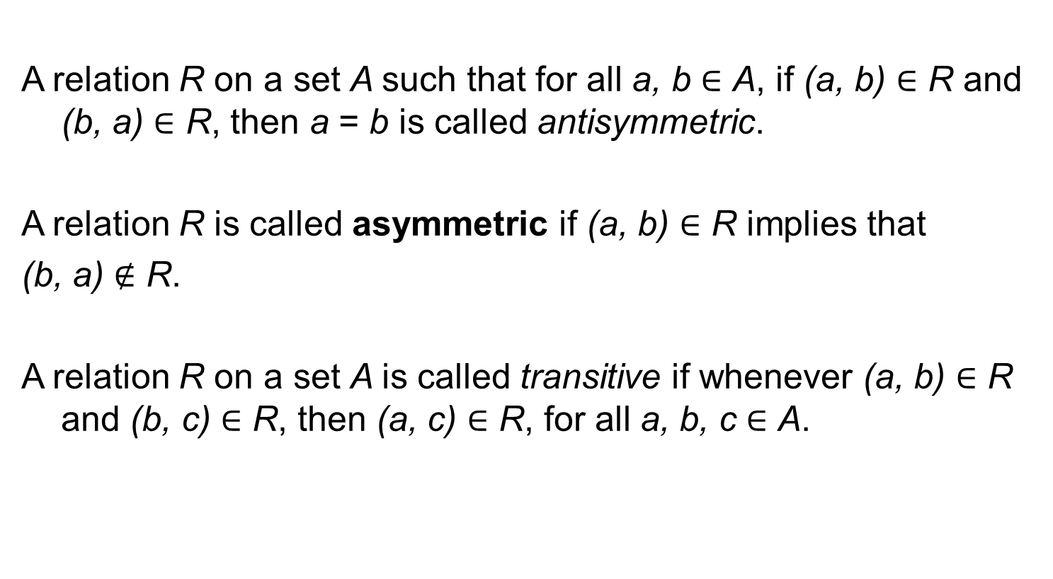
Cont..
A relation R on a set A such that for all a, b ∈ A, if (a, b) ∈ R and (b, a) ∈ R, then a = b is called antisymmetric.
A relation R is called asymmetric if (a, b) ∈ R implies that
(b, a) $∉$ R.
A relation R on a set A is called transitive if whenever (a, b) ∈ R and (b, c) ∈ R, then (a, c) ∈ R, for all a, b, c ∈ A.

Slide 6
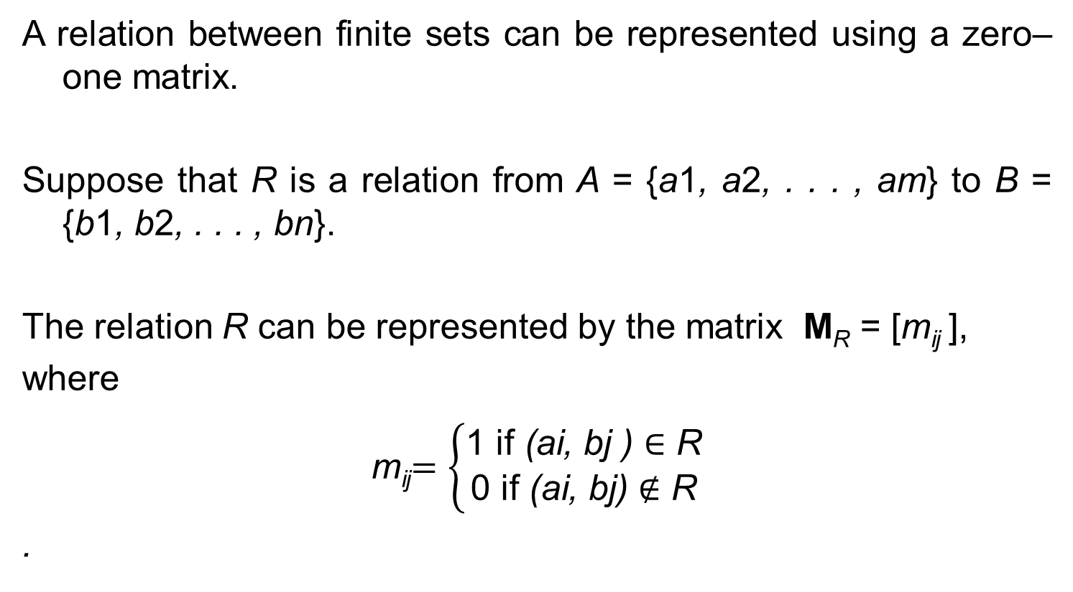
Representing Relations
A relation between finite sets can be represented using a zero–one matrix.
Suppose that R is a relation from A = {a1, a2, . . . , am} to B = {b1, b2, . . . , bn}.
The relation R can be represented by the matrix M_{R} = [m_{ij} ],
where
m_{ij}$=\left\{\begin{aligned}\text{1 }\text{if} \text{(}\text{ai}\text{, }\text{bj}\text{ ) }\text{∈ }\text{R} \\ \text{0 }\text{if} \text{(}\text{ai}\text{, }\text{bj}\text{)}∉\text{R}\end{aligned}\right.$
.

Slide 7
Reflexive :
A relation R on A is reflexive if (a, a) ∈ R whenever a ∈ A.
Thus, R is reflexive if and only if (a_{i}, a_{i}) ∈ R for i = 1, 2, . . . , n.
Hence, R is reflexive if and only if m_{ii} = 1, for i = 1, 2, . . . , n.
In other words, R is reflexive if all the elements on the main diagonal of M_{R} are equal to 1.
Note that the elements off the main diagonal can be either 0 or 1

Slide 8
Symmetric
The relation R is symmetric if (a, b) ∈ R implies that (b, a) ∈ R. Consequently, the relation R on the set A = {a1, a2, . . . , an} is symmetric if and only if (aj, ai) ∈ R whenever (ai, aj ) ∈ R.
In terms of the entries of M_{R}, R is symmetric if and only if m_{ji} = 1 whenever m_{ij} = 1.
This also means m_{ji} = 0 whenever m_{ij} = 0. Consequently, R is symmetric if and only if m_{ij} = m_{ji} , for all pairs of integers i and j with i = 1, 2, . . . , n and j = 1, 2, . . . , n.
Recalling the definition of the transpose of a matrix, we see that R is symmetric if and only if M_{R} = (M_{R})^{t} , that is, if M_{R} is a symmetric matrix.

Slide 9
Antisymmetric
The relation R is antisymmetric if and only if (a, b) ∈ R and (b, a) ∈ R imply that a = b.
Consequently, the matrix of an antisymmetric relation has the property that if m_{ij} = 1 with i ≠ j , then m_{ji} = 0.
Or, in other words, either m_{ij} = 0 or m_{ji} = 0 when i ≠ j .

Slide 10
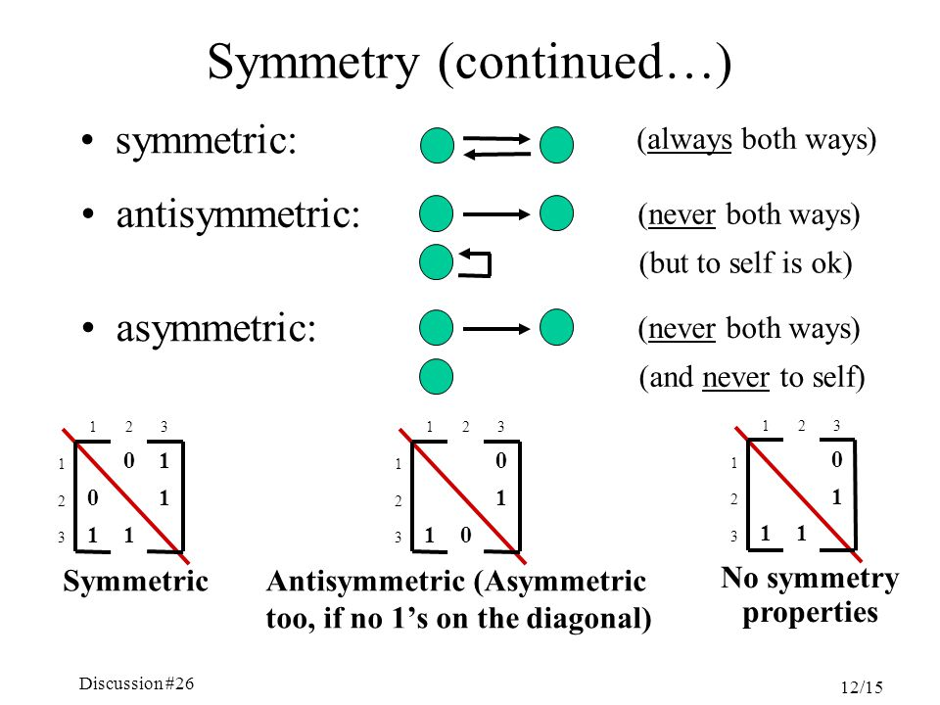
Symmetry

Slide 11
Boolean operations
Suppose that R₁ and R₂ are relations on a set A represented by the matrices M_{R1} and M_{R2} , respectively.
The matrix representing the union of these relations has a 1 in the positions where either M_{R1} or M_{R2} has a 1.
The matrix representing the intersection of these relations has a 1 in the positions where bothM_{R1} and M_{R2} have a 1.

Slide 12
Union and intersection
Thus, the matrices representing the union and intersection of these relations are
M_{R1∪R2}= M_{R1} ∨ MR2 and M_{R1∩R2} = MR1∧ MR2

Slide 13
Composite of relations
Suppose that R is a relation from A to B and S is a relation
from B to C.
Suppose that A, B, and C have m, n, and p elements, respectively.
Let the zero– one matrices for S ◦R, R, and S be M_{S ◦R} = [t_{ij} ], M_{R} = [r_{ij} ], and M_{S} = [s_{ij} ], respectively.
(these matrices have sizes m × p, m × n, and n × p, respectively).

Slide 14
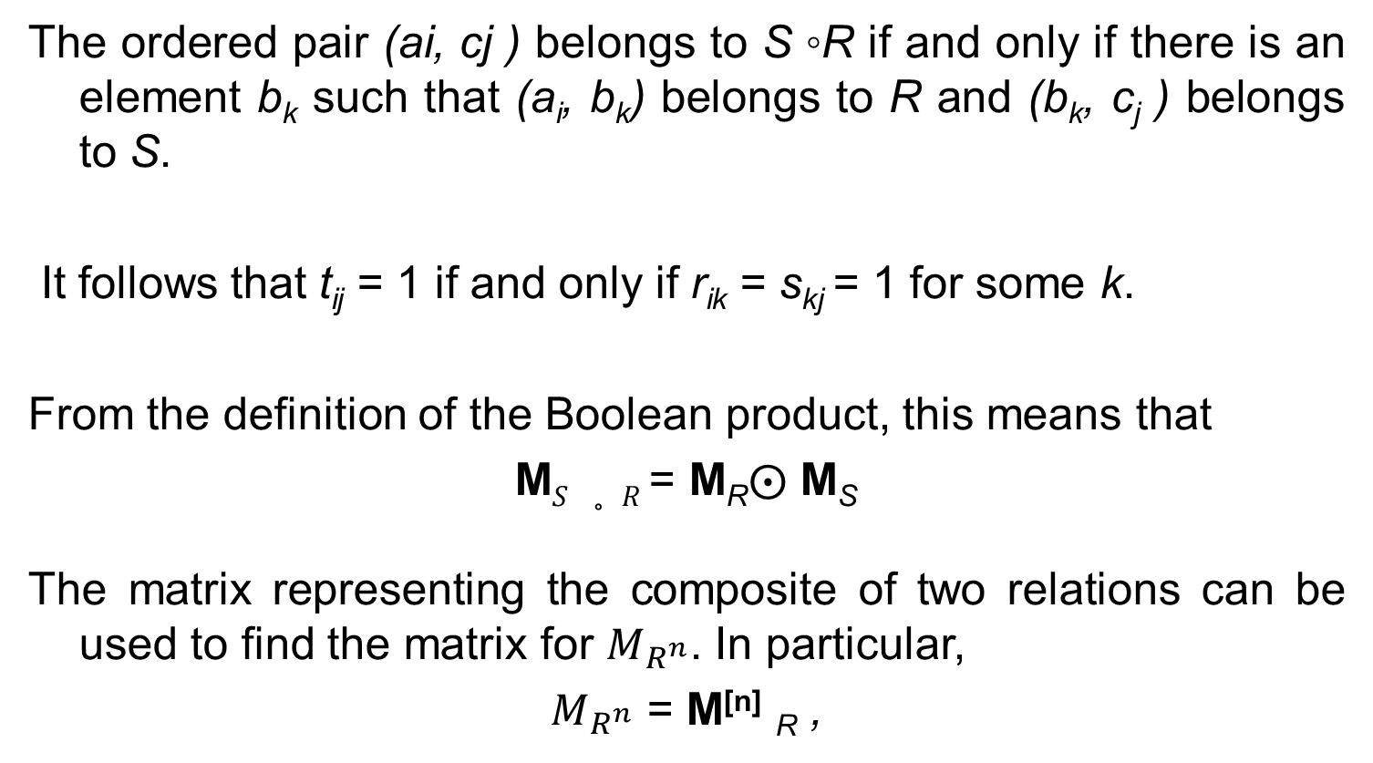
Boolean product
The ordered pair (ai, cj ) belongs to S ◦R if and only if there is an element b_{k} such that (a_{i}, b_{k}) belongs to R and (b_{k}, c_{j} ) belongs to S.
It follows that t_{ij} = 1 if and only if r_{ik} = s_{kj} = 1 for some k.
From the definition of the Boolean product, this means that
M$S ◦R$= M_{R}$⨀$ M_{S}
The matrix representing the composite of two relations can be used to find the matrix for $M_{R^{n}}$. In particular,
$M_{R^{n}}$ = M^{[n]} _{R} ,

Slide 15
Directed Graph
A directed graph, or digraph, consists of a set V of vertices (or nodes) together with a set E of ordered pairs of elements of V called edges (or arcs).
The vertex a is called the initial vertex of the edge (a, b), and the vertex b is called the terminal vertex of this edge.
An edge of the form (a, a) is represented using an arc from the vertex a back to itself. Such an edge is called a loop.

Slide 16
Digraph in terms of reflexive, symmetric and transitive
For instance, a relation is reflexive if and only if there is a loop at every vertex of the directed graph, so that every ordered pair of the form (x, x) occurs in the relation.
A relation is symmetric if and only if for every edge between distinct vertices in its digraph there is an edge in the opposite direction, so that (y, x) is in the relation whenever (x, y) is in the relation.
Similarly, a relation is antisymmetric if and only if there are never two edges in opposite directions between distinct vertices.
.

Slide 17
Digraph in terms of reflexive, symmetric and transitive
Finally, a relation is transitive if and only if whenever there is an edge from a vertex x to a vertex y and an edge from a vertex y to a vertex z, there is an edge from x to z (completing a triangle where each side is a directed edge with the correct direction).
Remark: Note that a symmetric relation can be represented by an undirected graph, which is a graph where edges do not have directions.

Slide 18
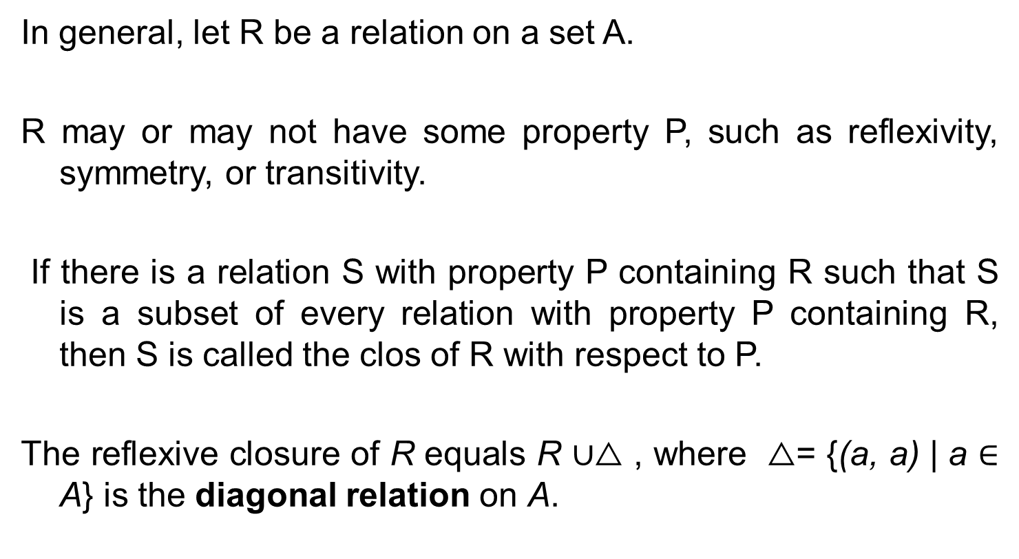
Closures
In general, let R be a relation on a set A.
R may or may not have some property P, such as reflexivity, symmetry, or transitivity.
If there is a relation S with property P containing R such that S is a subset of every relation with property P containing R, then S is called the clos of R with respect to P.
The reflexive closure of R equals R ∪$△$ , where $△$= {(a, a) | a ∈ A} is the diagonal relation on A.

Slide 19
Symmetric closures
The symmetric closure of a relation R can be constructed by
adding all ordered pairs of the form (b, a), where (a, b) is in the relation, that are not already present in R.
Adding these pairs produces a relation that is symmetric, that contains R, and that is contained in any symmetric relation that contains R.
The symmetric closure of a relation can be constructed by taking the union of a relation with its inverse, R ∪ R⁻¹ is the symmetric closure of R, where
R⁻¹ = {(b, a) | (a, b) ∈ R}.

Slide 20
Transitive closure
R = {(1, 3), (1, 4), (2, 1), (3, 2)} on the set {1, 2, 3, 4}. This relation is not transitive because it does not contain all pairs of the form (a, c) where (a, b) and (b, c) are in R. The pairs of this form not in R are (1, 2), (2, 3), (2, 4), and (3, 1).
Adding these pairs does not produce a transitive relation, because the resulting relation contains (3, 1) and (1, 4) but does not contain(3, 4).
This shows that constructing the transitive closure of a relation is more complicated than constructing either the reflexive or symmetric closure.

Slide 21
Path, length, circuit or cycle
A path from a to b in the directed graph G is a sequence of
edges (x0, x1), (x1, x2), (x2, x3), . . . , (xn−1, xn) in G, where n
is a nonnegative integer, and x0 = a and xn = b, that is, a sequence of edges where the terminal vertex of an edge is
the same as the initial vertex in the next edge in the path.
This path is denoted by x0, x1, x2, . . . , xn−1, xn and has
length n.
We view the empty set of edges as a path of length zero from a to a.
A path of length n ≥ 1 that begins and ends at the same vertex is called a circuit or cycle.

Slide 22
Transitive closures
A path in a directed graph can pass through a vertex more than once. Moreover, an edge in a directed graph can occur more than once in a path.
The term path also applies to relations. Carrying over the definition from directed graphs to relations, there is a path from a to b in R if there is a sequence of elements a, x1, x2, . . . , xn−1, b with (a, x1) ∈ R, (x1, x2) ∈ R, . . . , and (xn−1, b) ∈ R.
Let R be a relation on a set A. The connectivity relation R∗ consists of the pairs (a, b) such that there is a path of length at least one from a to b in R. The transitive closure of a relation R equals the connectivity relation R∗.

Slide 23
Transitive closure
Let M_{R} be the zero–one matrix of the relation R on a set with n elements. Then the zero–one matrix of the transitive closure R∗ is
M_{R}∗ = M_{R} ∨M^{[2]}_{R}∨M^{[3]}_{R}∨ ・ ・ ・ ∨M^{[n]}_{R} .
Warshall’s Algorithm: ( n elements using 2n³(n − 1) bit operations)

Slide 24
Algorithm

Slide 25
Equivalence relation
A relation on a set A is called an equivalence relation if it is reflexive, symmetric, and transitive.
Two elements a and b that are related by an equivalence relation are called equivalent. The notation a ∼ b is often used to denote that a and b are equivalent elements with respect to a particular equivalence relation.

Slide 26
Equivalence class
Let R be an equivalence relation on a set A. The set of all elements that are related to an element a of A is called the equivalence class of a. The equivalence class of a with respect to R is denoted by [a]_{R}. When only one relation is under consideration, we can delete the subscript R and write [a] for this equivalence class.
[a] = {x ∈ A | x R a}, ∀x ∈ A, x ∈ [a] ⇔ x R a.
Let R be an equivalence relation on a set A. These statements for elements a and b of A are equivalent: (i) aRb (ii) [a] = [b] (iii) [a] ∩ [b] = ∅.

Slide 27
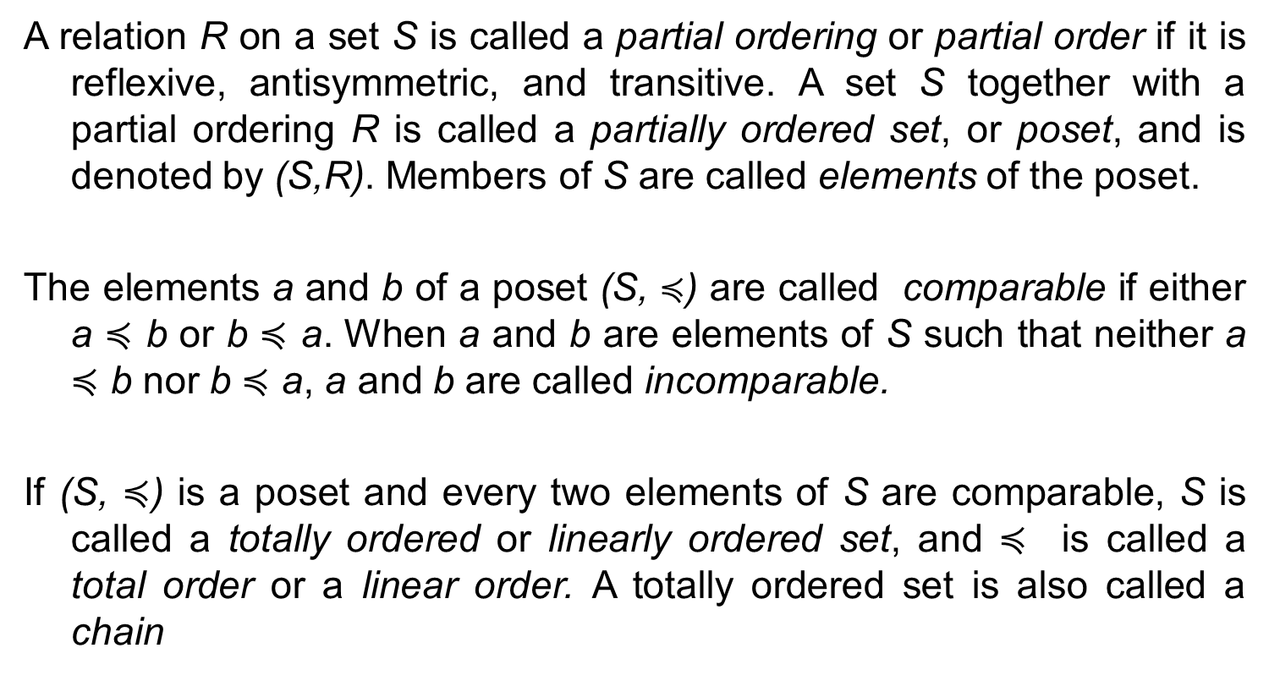
Poset
A relation R on a set S is called a partial ordering or partial order if it is reflexive, antisymmetric, and transitive. A set S together with a partial ordering R is called a partially ordered set, or poset, and is denoted by (S,R). Members of S are called elements of the poset.
The elements a and b of a poset (S, $≼$) are called comparable if either a $≼$ b or b $≼$ a. When a and b are elements of S such that neither a $≼$ b nor b $≼$ a, a and b are called incomparable.
If (S, $≼$) is a poset and every two elements of S are comparable, S is called a totally ordered or linearly ordered set, and $≼$ is called a total order or a linear order. A totally ordered set is also called a chain

Slide 28
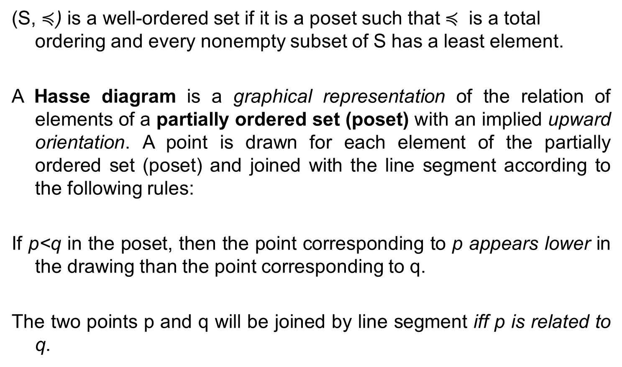
Hasse diagram
(S, $≼$) is a well-ordered set if it is a poset such that $≼$ is a total ordering and every nonempty subset of S has a least element.
A Hasse diagram is a graphical representation of the relation of elements of a partially ordered set (poset) with an implied upward orientation. A point is drawn for each element of the partially ordered set (poset) and joined with the line segment according to the following rules:
If p<q in the poset, then the point corresponding to p appears lower in the drawing than the point corresponding to q.
The two points p and q will be joined by line segment iff p is related to q.

Slide 29
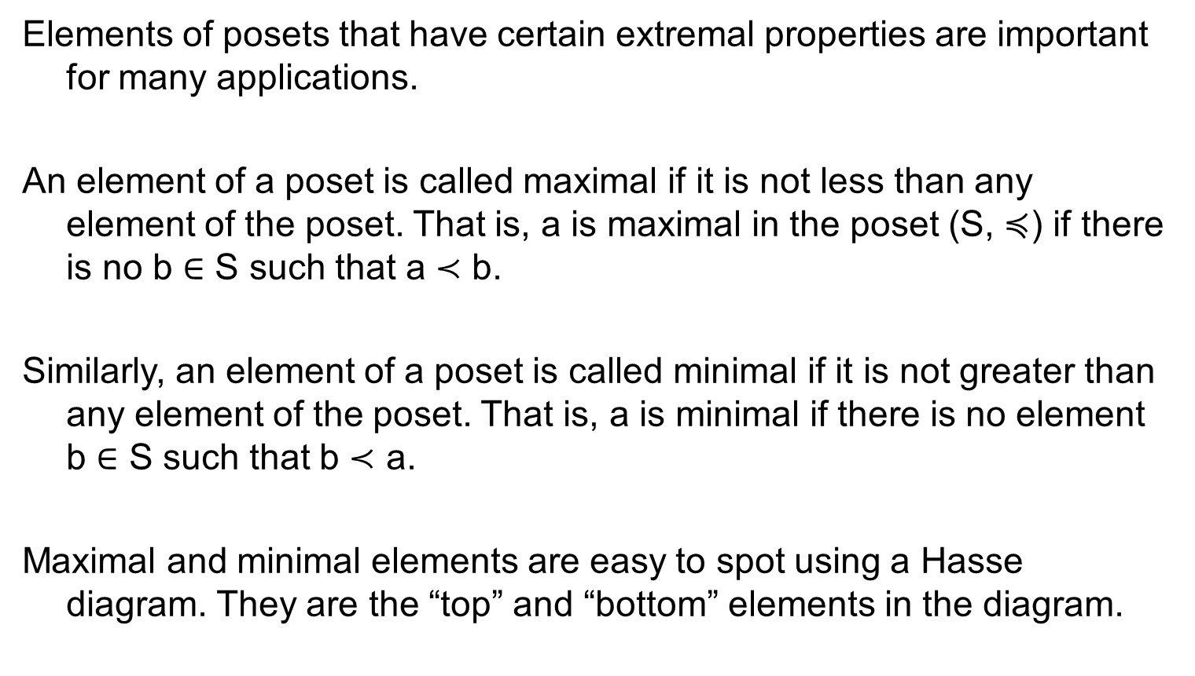
Maximal and minimal elements
Elements of posets that have certain extremal properties are important for many applications.
An element of a poset is called maximal if it is not less than any element of the poset. That is, a is maximal in the poset (S, $≼$) if there is no b ∈ S such that a ≺ b.
Similarly, an element of a poset is called minimal if it is not greater than any element of the poset. That is, a is minimal if there is no element b ∈ S such that b ≺ a.
Maximal and minimal elements are easy to spot using a Hasse diagram. They are the “top” and “bottom” elements in the diagram.

Slide 30
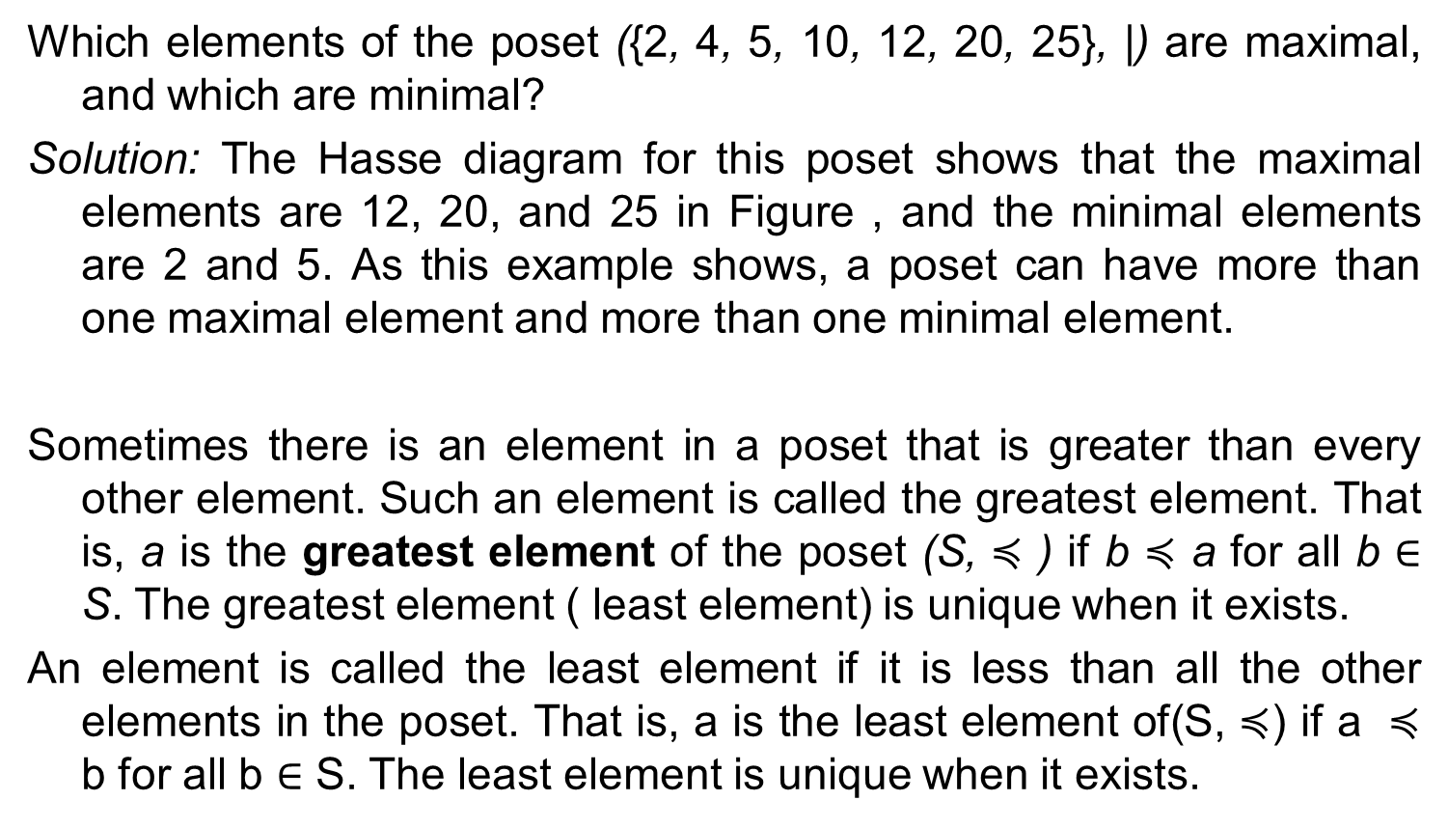
Example
Which elements of the poset ({2, 4, 5, 10, 12, 20, 25}, |) are maximal, and which are minimal?
Solution: The Hasse diagram for this poset shows that the maximal elements are 12, 20, and 25 in Figure , and the minimal elements are 2 and 5. As this example shows, a poset can have more than one maximal element and more than one minimal element.
Sometimes there is an element in a poset that is greater than every other element. Such an element is called the greatest element. That is, a is the greatest element of the poset (S, $≼$ ) if b $≼$ a for all b ∈ S. The greatest element ( least element) is unique when it exists.
An element is called the least element if it is less than all the other elements in the poset. That is, a is the least element of(S, $≼$) if a $≼$ b for all b ∈ S. The least element is unique when it exists.

Slide 31
Example
Is there a greatest element and a least element in the poset
(Z⁺ , |)?
Solution: The integer 1 is the least element because 1|n whenever n is a positive integer. Because there is no integer that is divisible by all positive integers, there is no greatest element.

Slide 32
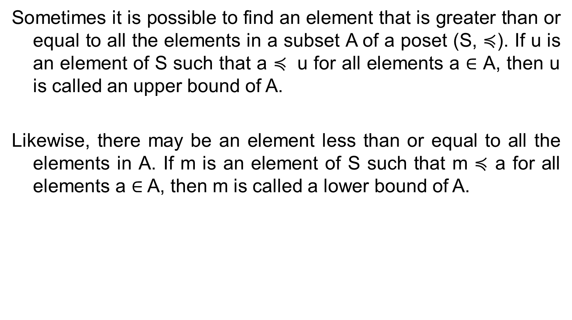
Upper and Lower bounds
Sometimes it is possible to find an element that is greater than or equal to all the elements in a subset A of a poset (S, $≼$). If u is an element of S such that a $≼$ u for all elements a ∈ A, then u is called an upper bound of A.
Likewise, there may be an element less than or equal to all the elements in A. If m is an element of S such that m $≼$ a for all elements a ∈ A, then m is called a lower bound of A.

Slide 33
*Find the lower and upper bounds of the subsets {a, b, c}, {j, h}, and {a, c, d, f } in the poset with the Hasse diagram.
Solution: The upper bounds of {a, b, c} are e, f, j, and h, and its only lower bound is a.
There are no upper bounds of {j, h}, and its lower bounds are a, b, c, d, e, and f .
The upper bounds of {a, c, d, f } are f , h, and j , and its lower bound is a.
*Find the greatest lower bound and the least upper bound of {b, d, g}, if they exist, in the poset.
The upper bounds of {b, d, g} are g and h. Because g ≺ h, g is the least upper bound.
The lower bounds of {b, d, g} are a and b. Because a ≺ b, b is the greatest lower bound.

Slide 34
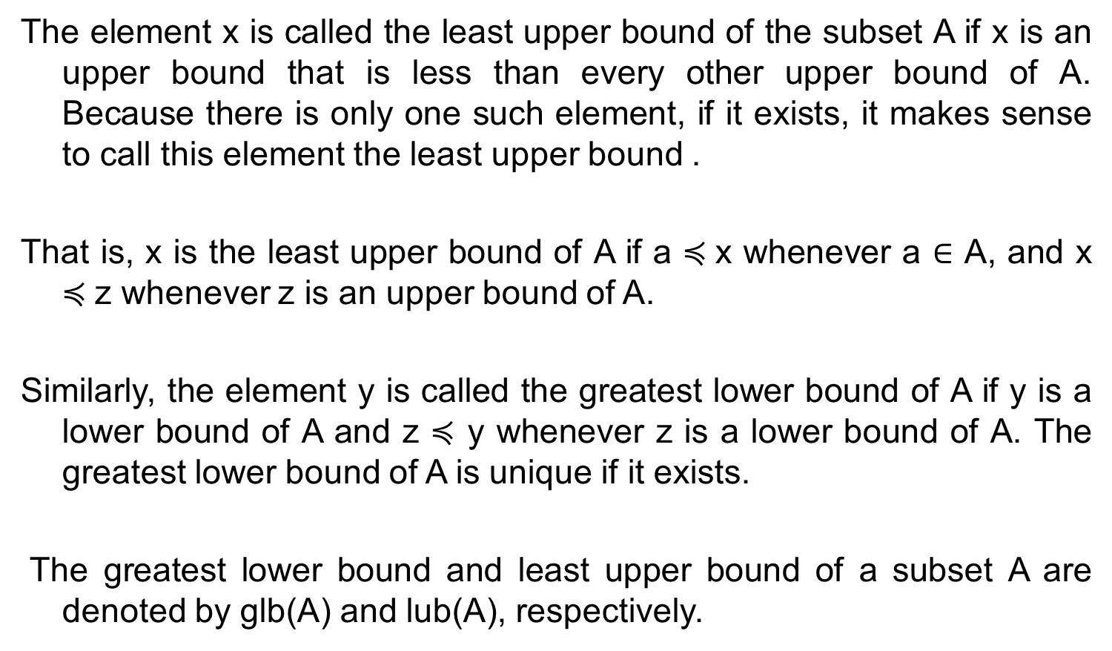
LUB and GLB
The element x is called the least upper bound of the subset A if x is an upper bound that is less than every other upper bound of A. Because there is only one such element, if it exists, it makes sense to call this element the least upper bound .
That is, x is the least upper bound of A if a $≼$x whenever a ∈ A, and x $≼$z whenever z is an upper bound of A.
Similarly, the element y is called the greatest lower bound of A if y is a lower bound of A and z $≼$ y whenever z is a lower bound of A. The greatest lower bound of A is unique if it exists.
The greatest lower bound and least upper bound of a subset A are denoted by glb(A) and lub(A), respectively.

Slide 35
Lattice
A partially ordered set in which every pair of elements has both a least upper bound and a greatest lower bound is called a lattice.
The posets represented by the Hasse diagrams in (a) and (c) are both lattices because in each poset every pair of elements has both a least upper bound and a greatest lower bound, as the reader should verify.

Slide 36
On the other hand, the poset with the Hasse diagram shown in (b) is not a lattice, because the elements b and c have no least upper bound. To see this, note that each of the elements d, e, and f is an upper bound, but none of these three elements precedes the other two with respect to the ordering of this poset.

Slide 37
Problems
Determine whether the relations represented by the matrix are reflexive, irreflexive, symmetric, antisymmetric, and/or transitive.

Slide 38
Problem

Slide 39
Problem
Let R be the relation on the set {0, 1, 2, 3} containing the ordered pairs (0, 1), (1, 1), (1, 2), (2, 0), (2, 2), and (3, 0). Find the a) reflexive closure of R. b) symmetric closure of R.
Let R be the relation on the set {1, 2, 3, 4, 5} containing the ordered pairs(1, 3),(2, 4),(3, 1),(3, 5),(4, 3),(5, 1), (5, 2), and (5, 4). Find a) R². b) R³. c) R⁴. d) R⁵. e) R⁶. f ) R∗.
Use Warshall’s algorithm to find the transitive closures of the relations in {(1, 2), (2,1), (2,3), (3,4), (4,1)}

Slide 40
Problem
Congruence Modulo m Let m be an integer with m > 1. Show that the relation R = {(a, b) | a ≡ b (mod m)} is an equivalence relation on the set of integers.
The equivalence classes of the relation congruence modulo m are called the congruence classes modulo m.
The congruence class of an integer a modulo m is denoted by [a]_{m}, so [a]_{m} = {...,a − 2m, a − m, a, a + m, a + 2m, . . .}.
What is the congruence class [4]_{m} when m is a) 2? b) 3? c) 6? d) 8?

Slide 41
Problem
Let R be the relation on the set of ordered pairs of positive integers such that ((a, b), (c, d)) ∈ R if and only if a + d = b + c.
a) Show that R is an equivalence relation.
b) What is the equivalence class of (1, 2) with respect to the equivalence relation?
c) Give an interpretation of the equivalence classes for the equivalence relation R.

Slide 42
Solution
R is reflexive: Suppose (a, b) is an ordered pair in Z × Z. [We must show that (a, b) R (a, b).]
We have a + b = a + b. Thus, by definition of R, (a, b) R (a, b).
R is symmetric: Suppose (a, b) and (c, d) are two ordered pairs in Z × Z and (a, b) R (c, d). [We must show that (c, d) R (a, b).] Since (a, b) R (c, d), a + d = b + c. But this implies that b + c = a + d, and so, by definition of R, (c, d) R (a, b).
R is transitive: Suppose (a, b),(c, d), and (e, f) are elements of Z × Z, (a, b) R (c, d), and (c, d) R (e, f). [We must show that (a, b) R (e, f).] Since (a, b) R (c, d), a + d = b + c, which means a − b = c − d, and since (c, d) R (e, f)C, c + f = d + e, which means c − d = e − f. Thus a − b = e − f, which means a + f = b + e, and so, by definition of R, (a, b) R (e, f).

Slide 43
Problem
Determine whether the relation with the directed graph shown is a partial order.
Find the duals of these posets. a) ({0, 1, 2}, ≤) b) (Z, ≥) c) (P (Z), ⊇) d) (Z+, |)
{(0, 0), (1, 0), (1, 1), (2, 0), (2, 1), (2, 2)} b) (Z, ≤) c) (P(Z), ⊆) d) (Z+, “is a multiple of”)

Slide 44
Problem
Answer these questions for the poset by drawing the Hasse diagram ({3, 5, 9, 15, 24, 45}, |).
a) Find the maximal elements.
b) Find the minimal elements.
c) Is there a greatest element?
d) Is there a least element?
e) Find all upper bounds of {3, 5}.
f ) Find the least upper bound of {3, 5}, if it exists.
g) Find all lower bounds of {15, 45}.
h) Find the greatest lower bound of {15, 45}, if it exists.

Slide 45
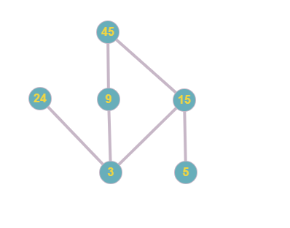
Solution

Slide 46
Sol..
Our maximal elements are 24 and 45.
Our minimal elements are 3 and 5. c)
There is no greatest element because this element would have to be a number that all other elements divide. Since our maximal elements are 24 and 45, and they do not divide each other, we do not have a greatest element.
There is no least element because this element would be a number that can divide all other elements. Since our minimal elements are 3 and 5, and they do not divide each other, we do not have a least element
15 and 45.
15.
3, 5, and 15.
15.

Slide 47
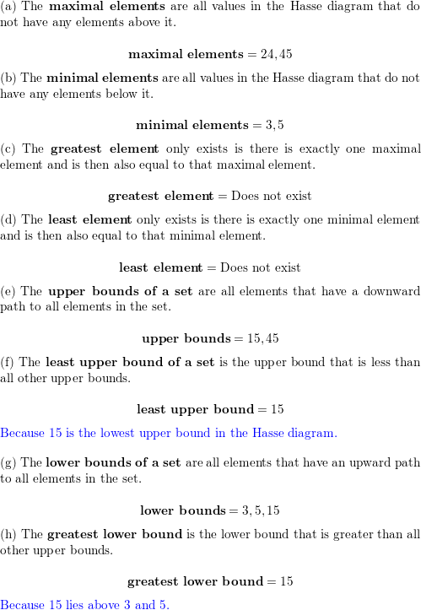
Solution

Slide 48
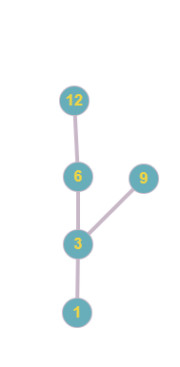
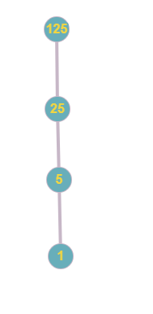
Problem
Determine whether these posets are lattices.
a) ({1,3,6,9,12},|) not a lattice because there are two maximal values
b) ({1,5,25,125},|) Lattice

